Slide 1
Deep Learning Practical 10 ( PSIT4P3a ) Aim: Denoising of images using autoencoders.
Durgesh Vishwakarma
MSc IT Sem4 2021-22
College: B. N. Bandodkar College of Science, Thane.
PRN: 2015430016

Slide 2
Table of Contents
What is an Autoencoder?
Architecture of Autoencoder
Implementation
Importing libraries and dataset
Adding Noise to MNIST Image dataset
Building Autoencoder model using Keras
Testing Autoencoder model
Conclusion

Slide 3

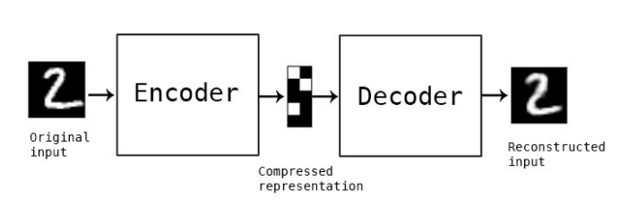
What is an Autoencoder?
Autoencoder is an unsupervised artificial neural network that is trained to copy its input to output. Let’s consider that we are given an image, an autoencoder will first encode the image into a lower-dimensional representation, then decodes the representation back to the image.

Slide 4
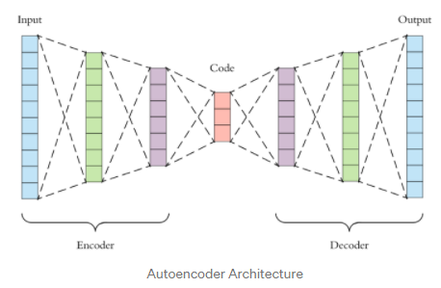
Architecture of Autoencoder
There are mainly 3 parts in autoencoders
Encoder: In this part of the architecture the model compresses the input data to represent the compressed data in a reduced dimension.
Code: Also known as Bottleneck this part of the architecture represents the compressed data that is going to be fed to the decoder.
Decoder: This part reconstructs the encoded data as close to the input data as possible. The output from the decoder is a lossy reconstruction of the original data.
The goal of an autoencoder is to get an output that is identical to the input. The dimensionality of the input and output is similar as obviously the goal is to get the output as identical to the input we can get.
They are trained similarly to ANNs via backpropagation

Slide 5
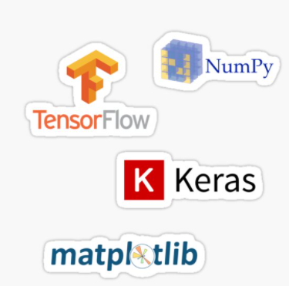
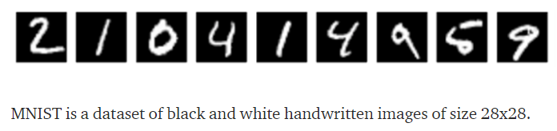
1. Importing libraries and dataset
In this example we will use some python libraries such as Keras, TensorFlow, NumPy and Matplotlib.
And for dataset we will use MNIST dataset from TensorFlow.

Slide 6
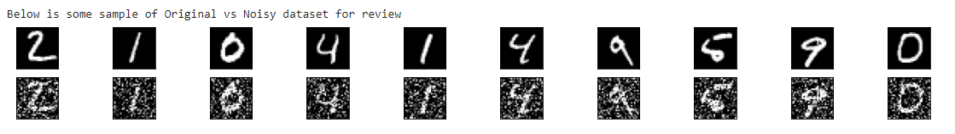
2. Adding Noise to MNIST Image dataset
In this stage we will add some noise to original MNIST dataset images and our Noisy dataset will look like below after transformation.
Later we will send this Noisy dataset to autoencoder as input.

Slide 7
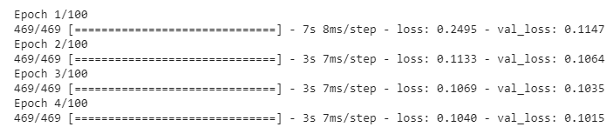
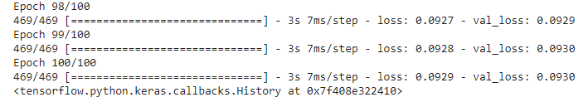
3. Building Autoencoder model using Keras
Here we will build an Autoencoder model using Keras and train it to 100 epochs for better output.
It may take few minutes to execute and produce output.
to

Slide 8
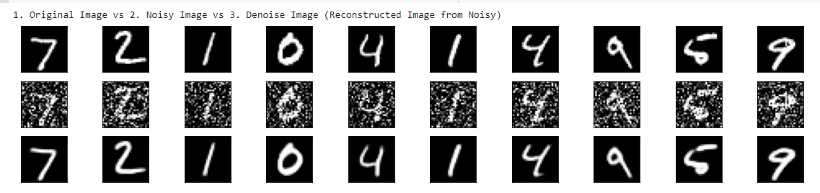
4. Testing Autoencoder model
As our Autoencoder model is ready now. We will compare below to test the model.
Original Image
Noisy Image
Denoised Image

Slide 9
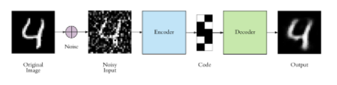
Conclusion
We have successfully performed following actions in Denoising of images using autoencoders.
Pulled Original image dataset from TensorFlow’s MNIST dataset.
Transformed Original Image into Noisy Image
Encoded Noisy Image into code using Keras’s autoencoders model.
Decoded Code to reconstruct Original Image using Keras’s autoencoders model.
For more details, please review document file of this.

Slide 10
Thank You!

